Slide 1
PSYCHOLOGY OF GIVING
Cassandra Chapman
10 May 2016

Slide 2
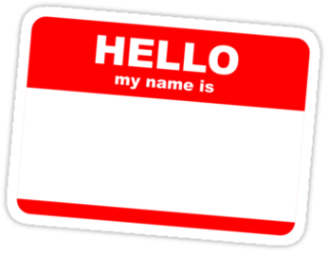
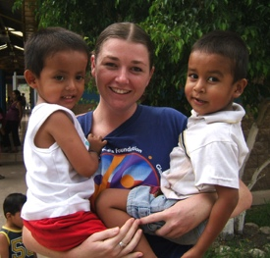
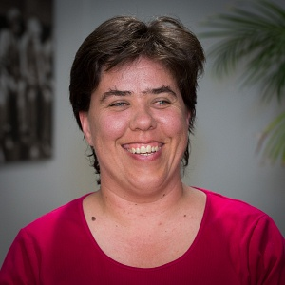
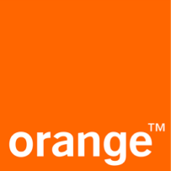
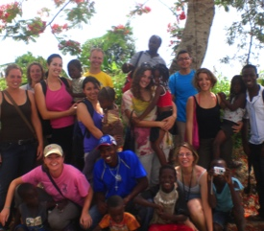
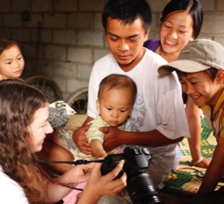
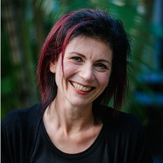
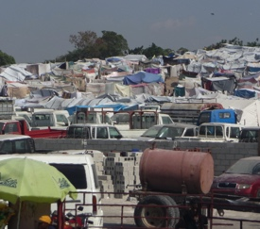
Cassandra
Chapman
Dr Winnifred Louis
Dr Barbara Masser

Slide 3
PSYCHOLOGY IN FUNDRAISING
Who gives to charity?
What can fundraisers learn from psychology?
Anchoring
Norms
Behavioural traces
Identity
Peer2peer
Ideas for action

Slide 4
WHO GIVES TO CHARITY?

Slide 5
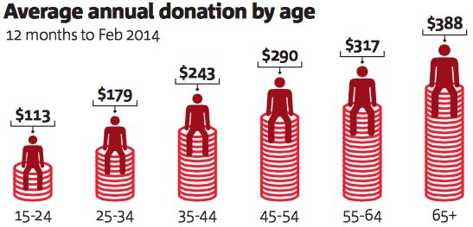
A TYPICAL DONOR
Female | ✔ | Women more likely to give and give greater proportion of income Men give more in absolute terms
Older | ✔
Income | ✔ | More money to give
Religious | ✔ | Give more on average, but generally to religious causes
Empathic | ✔ | Able to understand and share the experience of others: Empathic concern (emotional), perspective taking (cognitive), personal distress
Moral | ✔ | Self-importance of being a kind and caring person
Values Others | ✔ | Universalism Understanding, tolerance, & protection for welfare of all people Benevolence Preserving and enhancing the welfare of close others

Slide 6
WHAT ELSE AFFECTS GIVING?
Being labeled as ‘charitable’
Presence of other people
Knowing your donations will be made known to others
Trust in the charity
Impact of donation
Being asked - especially by an aquaintence

Slide 7
PSYCHOLOGY OF FUNDRAISING

Slide 8
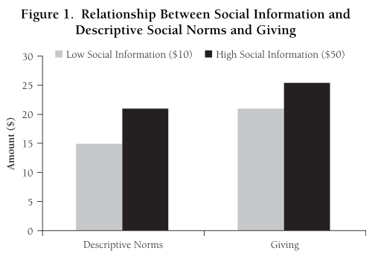
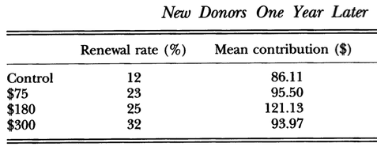
ANCHORING
Individuals use an initial piece of information to make subsequent judgments
Sales promotions
Ask ladders
Lower anchors lift response rate
Higher anchors lift donation value – to a point
Latitude of acceptance
Applications:
Fundraising targets
Donation form
First donation

Slide 9
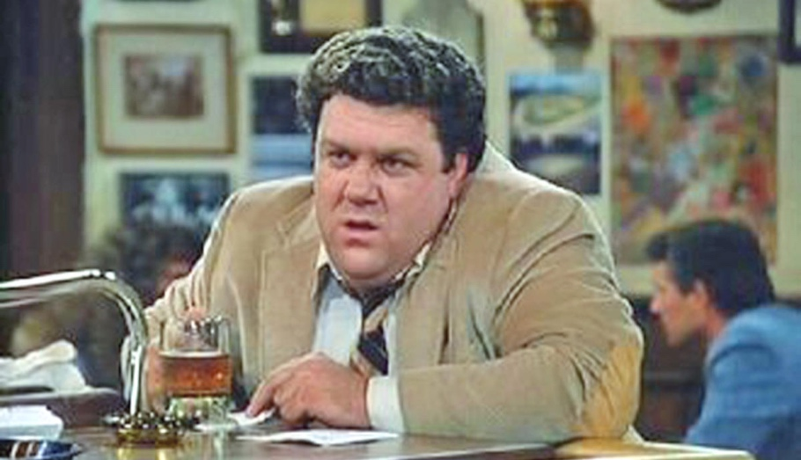
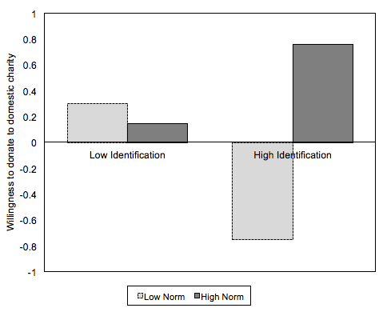
NORMS
Social norms are perceived descriptions or prescriptions of behaviour based on group membership
Injunctive norms (IN) = what others approve of
Descriptive norms (DN) = what others do
People actively try to guess what others will contribute and use that to decide what to give
Norms are associated with identities
Norms influence willingness to donate and choice of charity
Application:
Communications
Behavioural traces (next slide)

Slide 10
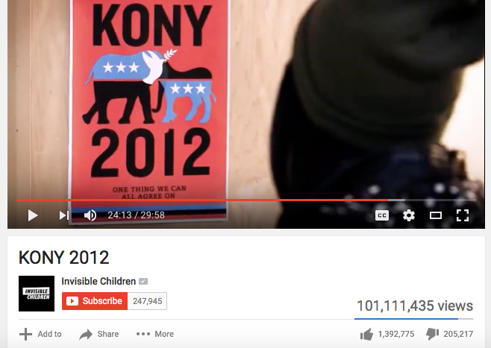
BEHAVIOURAL TRACES

Slide 11
BEHAVIOURAL TRACES

Slide 12
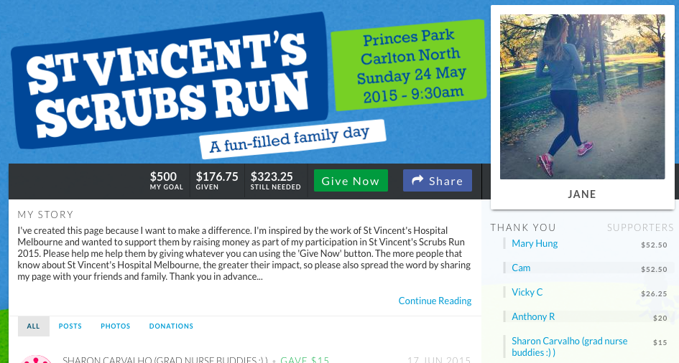
BEHAVIOURAL TRACES

Slide 13
BEHAVIOURAL TRACES
Norms in action
People infer information from visible traces of others’ behaviour or attitudes
What people see is what they perceive is done or approved of
Examples of behavioural traces:
Donations in a box
Poppy pin, daffodil, pink ribbon
Child sponsorship photo
Information about others’ gifts – telemarketing, online
Pledges on a visible list
Hence, the early donations matters most
Applications:
Coaching fundraisers – donate first, who to ask first
Wesbite design – gauge of donations (most recent first or largest first)
Social sharing buttons and messages

Slide 14
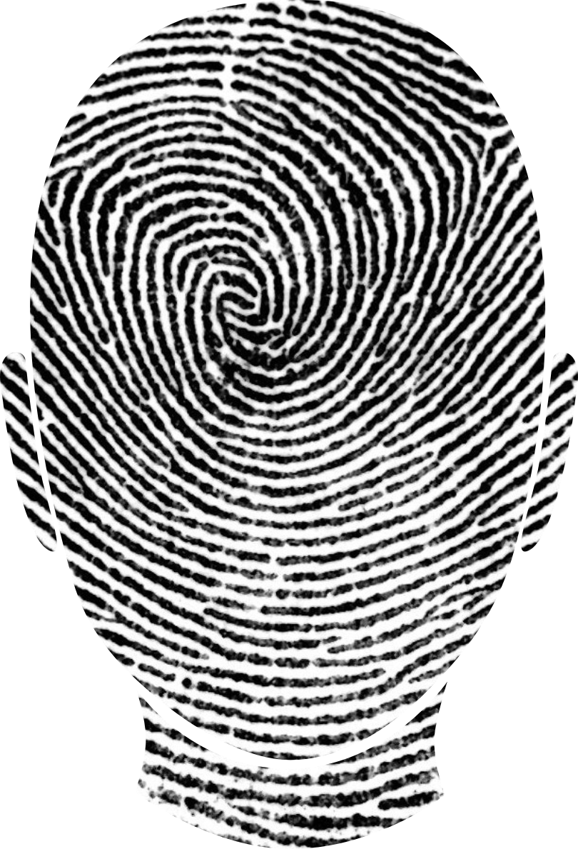
IDENTITY
Solicitations from people who share an identity are particularly powerful
Can affect likelihood of donating and value of gift
Example identities:
Gender
Nationality
Location/Region
Club membership
Workplace/school
Identification with the cause promote giving and, especially, promotion of the cause to others
Application
Coaching fundraisers – framing, targetting

Slide 15
PEER2PEER
Peer-to-peer education may minimise distrust of charities
Friends, colleagues, family are powerful solicitors because of shared/overlapping identities
Generation Y reject institutionalised giving
social networks encourage ‘sharing’ more than giving
solidarity is horizontal (sharing within the group/community) not vertical (societal institutions/non-profits)
JustGiving UK shows the ROI of a share:
Facebook = extra £4.50
Incentives encourage fundraisers to promote page through social networks:
14% posted without incentive vs
37% for $1 donation

Slide 16
PSYCHOLOGY IN ACTION

Slide 17
IDEAS FOR ACTION
Anchoring
Are your default options (fundraising targets, donation form) appropriate?
Norms
Are your norms supportive? (e.g. % of event participants fundraising, % who reach target, % of Australians that give to charity)
How could you make them salient?
Behavioural traces
Are fundraising pages designed to highlight supportive behavioural traces?
Identity
Can fundraisers be coached to make shared identities salient when soliciting?
Is identity inherent in the location of solicitation?
Incentives
Does the value of a ‘share’ allow for promotion incentives?

Slide 18
THANK YOU
c.chapman@psy.uq.edu.au

Slide 19
FURTHER READING
Berger, P. D., & Smith, G. E. (1997). The effect of direct mail framing strategies and segmentation variables on university fundraising performance. Journal of interactive marketing, 11(1), 30-43.
Castillo, M., Petrie, R., & Wardell, C. (2014). Fundraising through online social networks: a field experiment on peer-to-peer solicitation. Journal of Public Economics, 114, 29-35.
Cialdini, R. B. (2003). Crafting Normative Messages to Protect the Environment. Current Directions in Psychological Science, 12(4), 105-109.
Croson, R., Handy, F., & Shang, J. (2009). Keeping Up with the Joneses The Relationship of Perceived Descriptive Social Norms, Social Information, and Charitable Giving. Nonprofit Manag. Leadersh., 19(4), 467-489.
Kahneman, D. (2011). Thinking, fast and slow (1st ed. ed.). New York: New York : Farrar, Straus and Giroux 2011.

