Slide 1
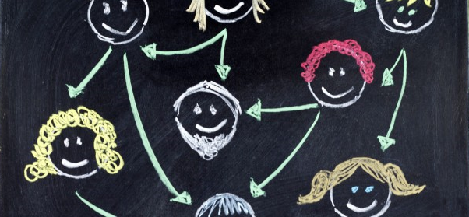
MAKING CONNECTIONS: 10 networking tips people who hate networking
Cassandra Chapman
18 March 2016

Slide 2
NETWORKING IS NOT…
Being fake
Sucking up to people
Selling yourself
Only for extroverts
Only instrumental
The elevator speech

Slide 3
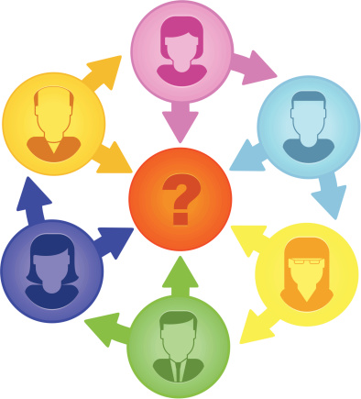
WHY BOTHER?
Discuss ideas
Ask for feedback
Hear about job opportunities
Prepare for job interviews
Research collaborations
Industry, public sector, or media connections
Funding opportunities
Reviewers may know you
Support and friendship

Slide 4
YOU’RE ALREADY DOING IT
Supervisors
CRiSP colleagues
Lunch and Friday drinks
Summer schools
Service roles
Conferences - attending, presenting, posters, panels, mingling
Friends and family
LinkedIn, Twitter, Facebook, ResearchGate, Academia

Slide 5
10 NETWORKING TIPS

Slide 6
1. PREPARE FOR REJECTION
Academia is the business of rejection
Most networking will not lead to collaboration
A ‘no’ once is not a ‘no’ forever

Slide 7
2. BE PROACTIVE
Do your research
Who will be at events? Who is visiting your department?
What you want to talk about?
Schedule a meeting in advance – formal meeting or chat over coffee
Informational interview

Slide 8
3. BE GENUINE
Be sincere, not sleazy
Be interested, not interesting
Relax
Try to be yourself, not sell yourself
Build mutually-beneficial relationships
Networking is not just about work
Make friends first
May (one day) help in your career, may not
Ginuwine…

Slide 9
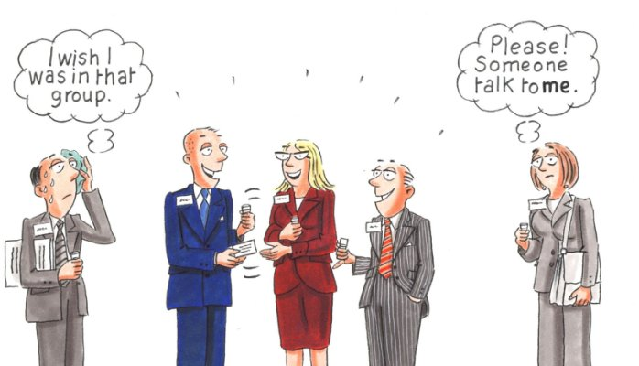
4. RESCUE OTHERS
Notes:
You’re not the only one who hates networking
Approach a loner and save them from their own networking hell
If you see other people just standing around invite them to join your new group

Slide 10
5. ADD VALUE FIRST
Cultivate mutually beneficial relationships
Share something with people you approach
Ideas, articles
Introductions
A smile
Offer your time and expertise (like an internship)
Be thankful

Slide 11
6. KEEP IT CLASSY
ONLINE
Social media is more public than you think
Potential employers will check
Check privacy settings regularly
If in doubt, don’t post
OFFLINE
Dress appropriately
Don’t be drunk
Be respectful – of them, yourself, your colleagues

Slide 12
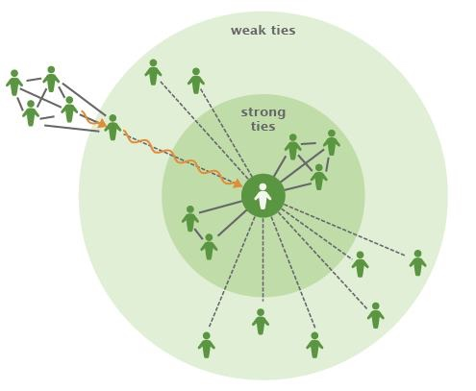
7. VALUE YOUR WEAK TIES
Close friends can’t open doors because you’re all in the same room
Weak ties hold up social networks
More novel information, ideas, opportunities
Status updates – job seeking, offers
Informational interview
Connections of connections
Ask for introduction
Weak ties are often more beneficial, especially in generating knowledge and creativity

Slide 13
8. EMBRACE SOCIAL MEDIA
LinkedIn, ResearchGate, Academia, Blog, Twitter, Groups, YouTube
Keep your profile up-to-date
Engage often
Let it be known – ask and you shall receive

Slide 14
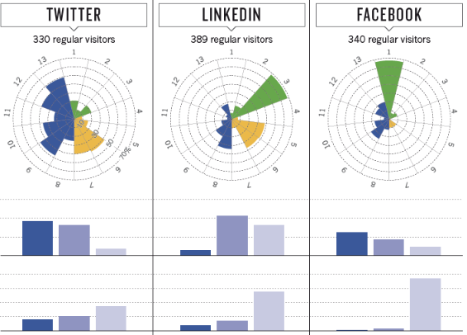
HOW ACADEMICS USE SOCIAL MEDIA

Slide 15
9. FOLLOW UP OR FORGET IT
Events are only the beginning
Make thoughtful contact (within 48 hours)
Email, LinkedIn, ResearchGate, phone call, follow up coffee
Make it useful to them and relevant to your discussion e.g. article, recipe

Slide 16
10. KEEP IN TOUCH
Don’t just reach out when you need something
Follow them on social media and engage
Share articles you discover that may be relevant
Check in via email

